Slide 1
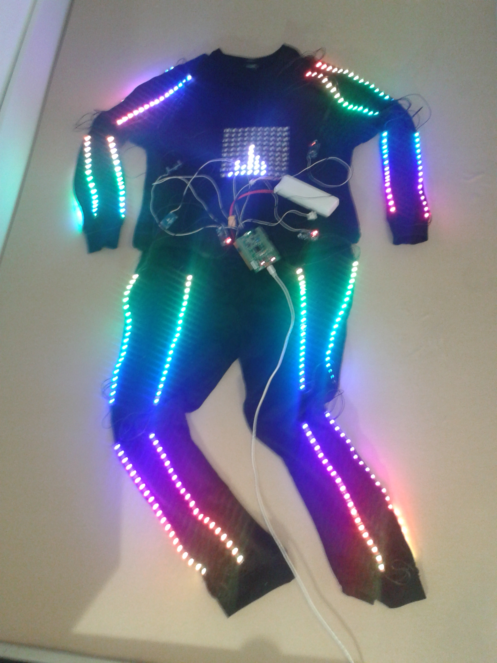

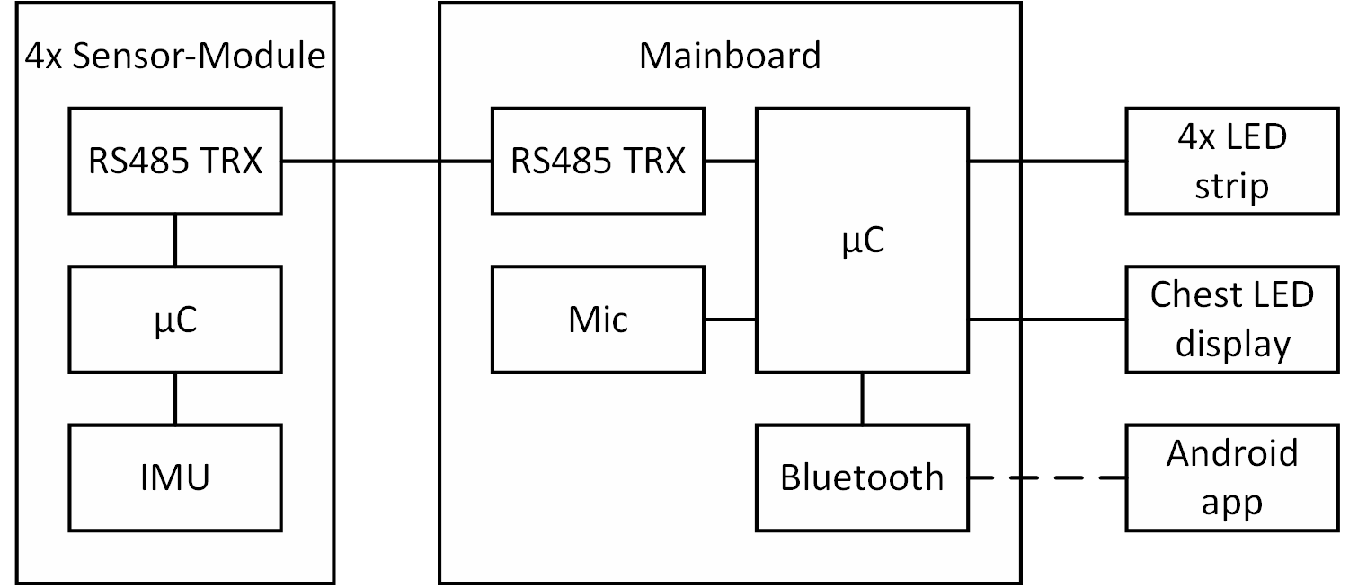
Smart dancing suit
Making music visible
The sound of the environment is measured by a microphone
LEDs react to the environment sound
Intelligent music recognition by applying fourier transform to the sound measurements
Displaying of the music spectrum on chest
Reacting to movements
Body movements are detected by IMUs mounted on hands and feet
LEDs react to the movements measured by the IMUs
Creating an audiovisual performance
LEDs change their colors and blinking patterns according to the music and the movements of the wearer
Suit behavior can be configured via android app
Generating an LED-choreography on the fly
TODO: fancy title
Positions of the sensors and LEDs on the suit
Schematc setup of the system
Arduino-compatible custom sensor board hardware
Sensor board communication over an RS485-based master-slave bus
STM32F4 discovery board with breadboard shield as mainboard
Individually addressable WS2812 RGB LEDs
Sound detection with adafruit MAX9814 microphone module
Communication with the android app via bluetooth
UART interface is used to set up the communication to the smartphone
User can selecet features for body parts
colors of the LED
colors for the colorfade function
turn on the spectrum
Choose the blinking pattern of the suit: Alwasy On, Stroboscope, Motion Detection
Design of the App
User can choose body parts, colors, blinking pattern and get Infos about the app.

